Slide 1
Year 2 Maths Meeting October 2023
Thank you for coming along.
Please ensure that your child sits with you throughout the meeting.

Slide 2
Year 2 Maths Curriculum
Building on from the Maths taught in Reception and Year 1:
Place value (0-120)
Identifying number patterns
Identifying odd and even numbers
2, 5 and 10 times table moving on to 3 times table (using the x and ÷ symbols)
Adding and subtracting two digit and single digit numbers (using the + and –symbols)
Measure: weight, length, telling the time (quarter of an hour/5 minute increments)
Statistics: creating and interpreting graphs (pictograms, bar charts, tally charts etc.)
Halving & doubling
Calculating ¹/₂ ¹/₃ ¹/₄ ²/₃ ²/₄ ³/₄ of a number (including multiples of 10)
2D and 3D shapes (right angles and lines of symmetry in 2D shapes)
Position and direction (clockwise and anticlockwise)
Notes:
Same principles

Slide 3
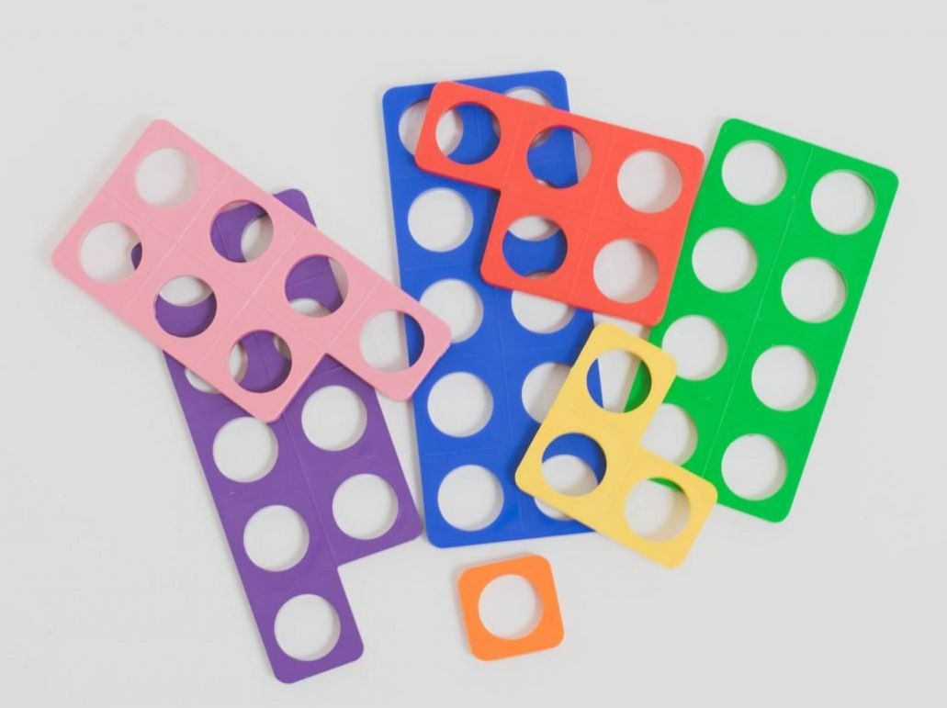
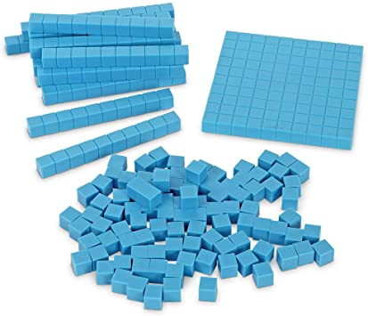
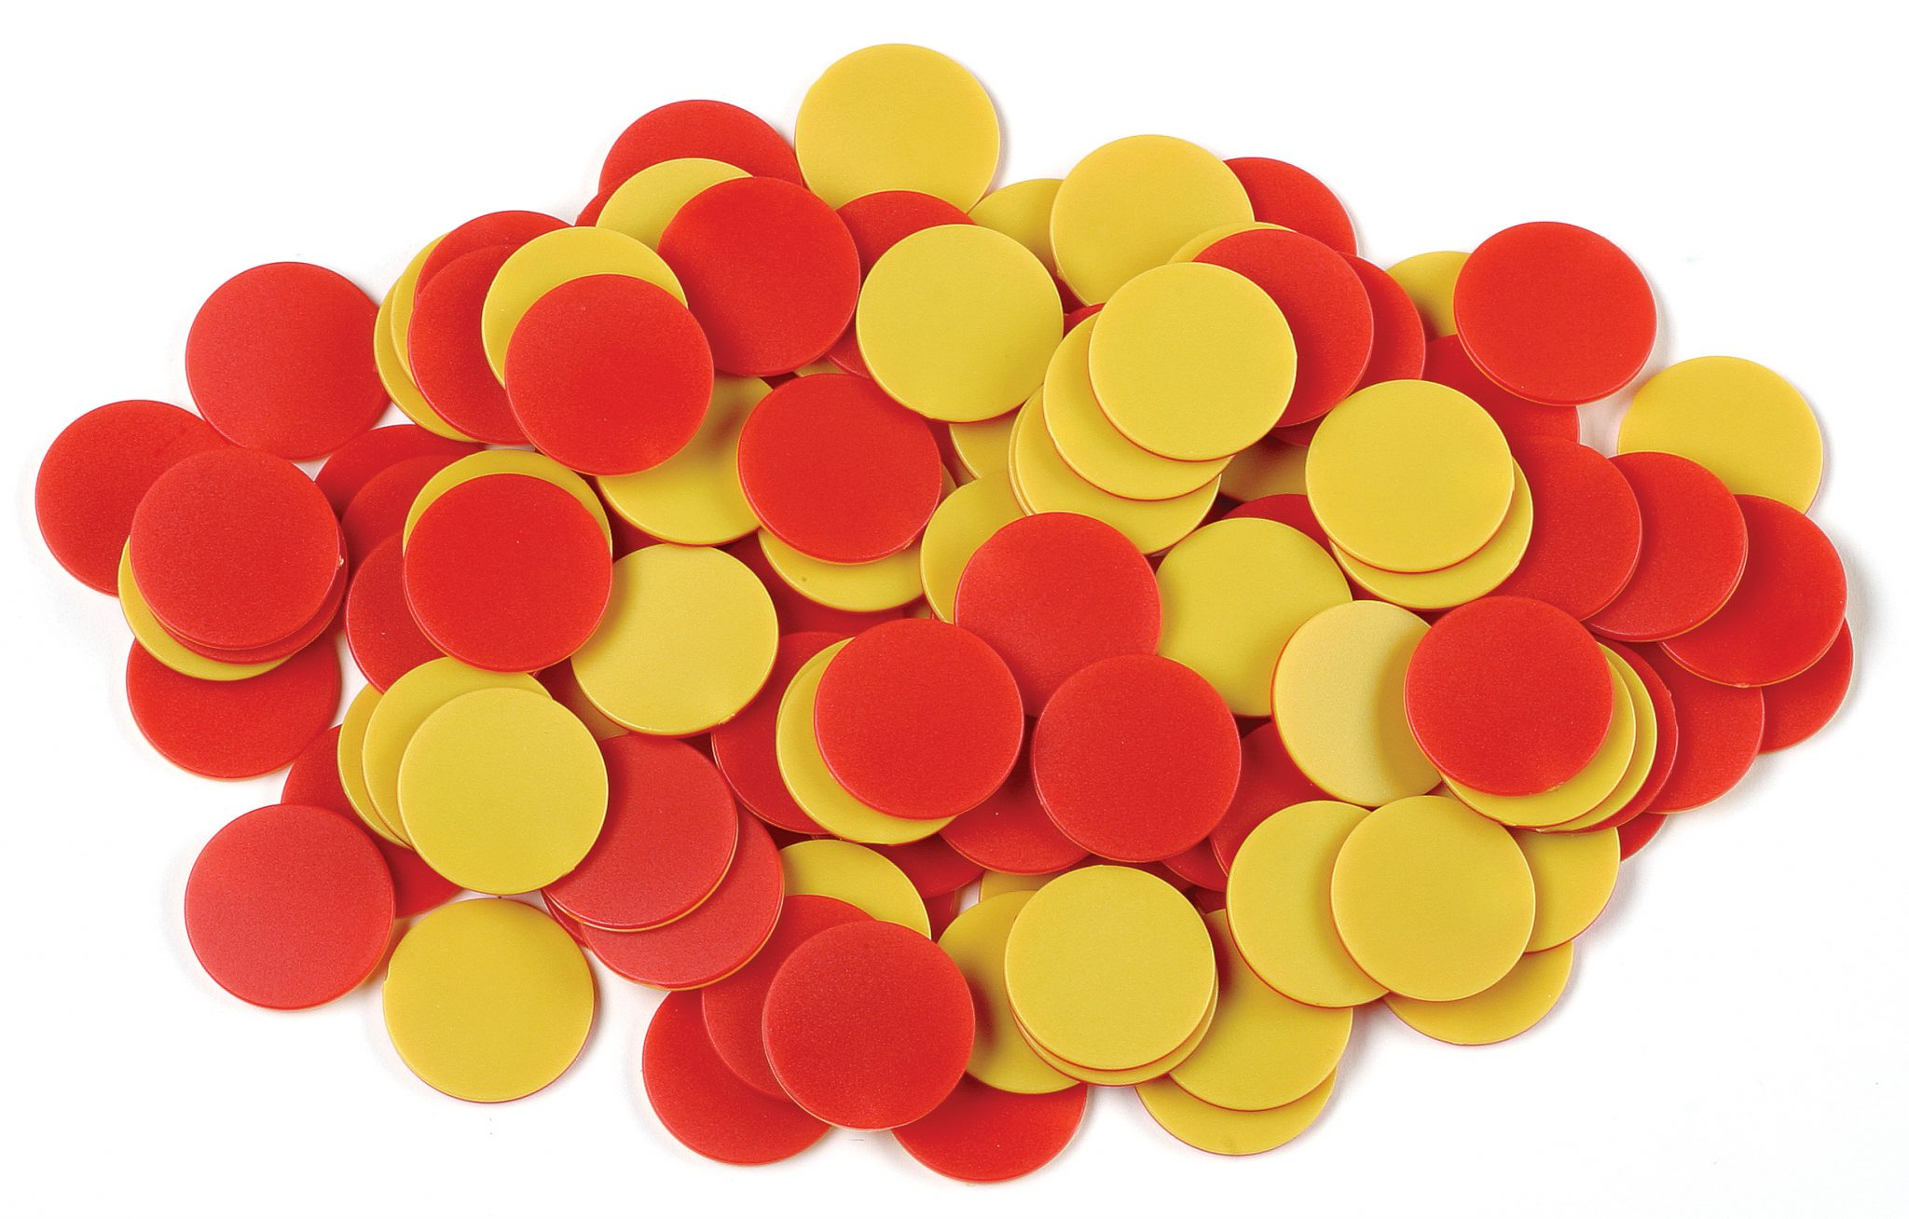
Maths in Year 2
Using apparatus to develop children’s confidence with manipulating numbers (Numicon, Dienes/Base Ten, counters)
Developing use of drawing methods for all four operations - formal methods (e.g. column addition and subtraction) are introduced in Year 3
Focusing on number – recall of number facts including number bonds up to 20 and times tables and division facts

Slide 4
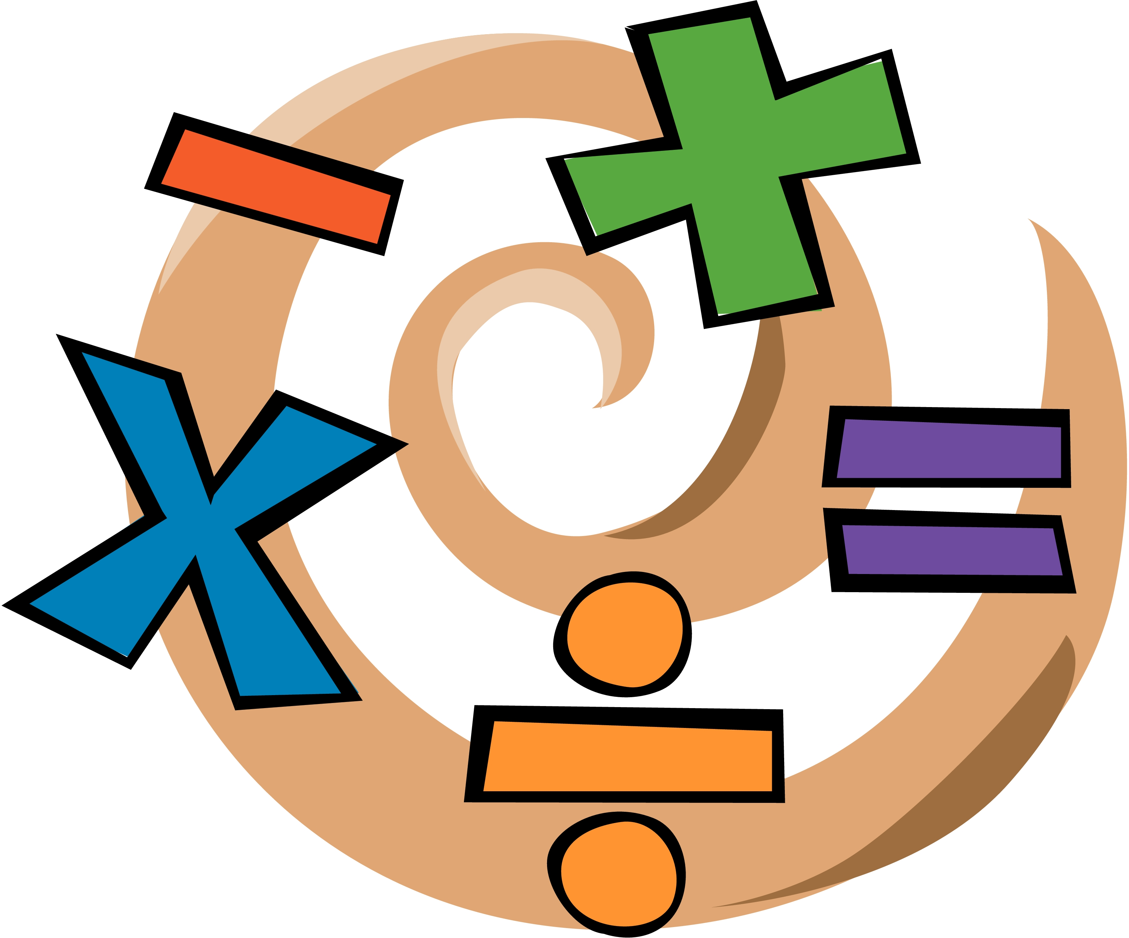
Arithmetic Methods
In Year 2, the children learn how to:
Add and subtract single and two digit numbers
Multiply and divide by 2, 3, 5, and 10
Calculate fractions of amounts

Slide 5
Understanding and Representing Numbers
Focus on understanding exactly what a numeral means:
45
We ask children to draw out numbers, so 45 would be:
4 tens is 40
5 ones is 5
Notes:
Focus on recall but can draw out if they prefer

Slide 6
Number Facts
Using the following knowledge to solve problems:
Number bonds within, and including, 20
Doubling/near doubles of numbers up to 10
Halving even numbers up to 20
4 + ___ = 10 | 5 + 13 = ___ | 3 + ___ = 17
6 + 6 = ___ | 8 + 9 = ____
14 = ___ + 7
Notes:
Focus on recall but can draw out if they prefer

Slide 7
Addition
For addition and subtraction, the children have been practising using Dienes/Base Ten and representing this by drawing out tens and ones.
2 3 + 4 6 =
5 2 + 3 4 =
Notes:
Ones like Numicon
Some children will be able to do this in their heads

Slide 8
Addition – Bridging Ten
For addition and subtraction, the children have been practising using Dienes/Base Ten and representing this by drawing out tens and ones.
2 5 + 4 6 =
5 8 + 3 4 =
Notes:
Ones like Numicon
Some children will be able to do this in their heads

Slide 9
Subtraction
For addition and subtraction, the children have been practising using Dienes/Base Ten and representing this by drawing out tens and ones.
2 3 - 1 2 =
5 6 - 3 4 =

Slide 10
Subtraction – Bridging Ten
For addition and subtraction, the children have been practising using Dienes/Base Ten and representing this by drawing out tens and ones.
2 3 - 6 =
5 6 - 3 8 =

Slide 11
Other examples of addition and subtraction are:
87 - 40 =
5 – 2 =
19 – 9 =
6 - __ = 4
___ + 4 = 9
Some children will draw the tens and ones and cross them out, others will count back in their head and some will use their number facts to work out the answers.
Children need to be able to recall number bonds within 20 from memory to support their addition and subtraction. Using inverse where necessary.

Slide 12
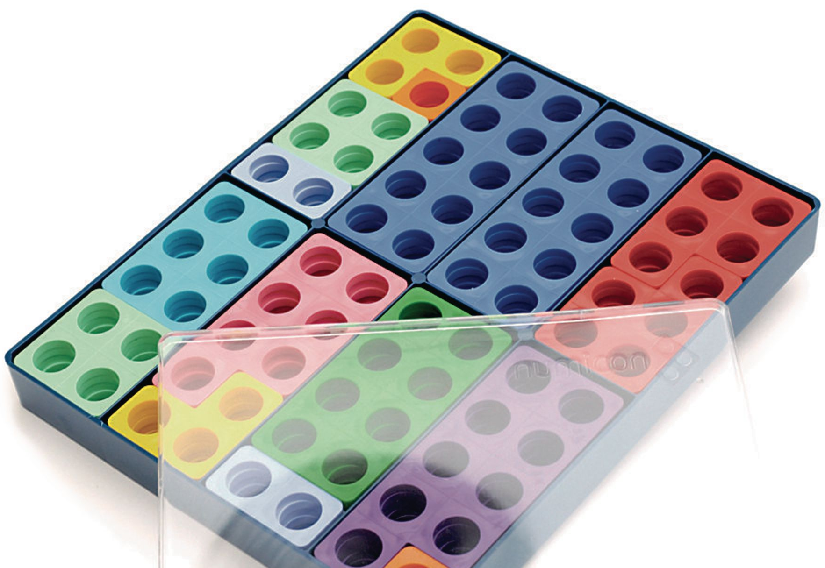
Adding Three Single Digit Numbers
Children need to know that addition can be done in any order.
Children can draw out ones to find the answer but preferably when adding three single digit numbers, children need to look for number bonds to 10 or doubles to help them calculate the answer.
3 + 7 + 5 =
6 + 6 + 7 =
9 + 1 + 6 =
Notes:
Ones like Numicon
Some children will be able to do this in their heads

Slide 13
Multiplication
Children need to recall times table facts for the 2, 5 and 10 times tables. If children are confident with this, they are given opportunities to practise the 3, 4, 6 and 8 times table.
Children need to know that multiplication can be done in any order e.g. the answer to 2 x 3 is the same as 3 x 2.
Children should be able to count in 2s, 5s and 10s and move on to counting in 3s and recalling the three times tables.
Children must also remember that anything multiplied by zero is zero, e.g. zero lots of two biscuits equals no biscuits!
Notes:
Ones like Numicon
Some children will be able to do this in their heads

Slide 14
Multiplication & Division
Using their knowledge of times tables, children should be able to recognise the inverse (division).
When dividing, we ask the children to draw an arrow:
This reminds us that we are thinking about ‘how many fives there are in 15’.
Children will then recall, 5 x 3 = 15 or they can count up in 5s to see how many 5s are needed to make 15.
15 ÷ 5 =
Notes:
Ones like Numicon
Some children will be able to do this in their heads

Slide 15
Doubling and Halving
By the end of year 2, children need to recall doubles and halves fluently to 20.
Double 6 = 12 so Half of 12 = 6
Double 9 = 18 so Half of 18 = 9
We teach these facts together as they are connected.
Children will then go onto halve multiples of 10 e.g. half of 80 is 40 and find half of two digit even numbers e.g. Half of 84 = 42
Notes:
Ones like Numicon
Some children will be able to do this in their heads

Slide 16
Halving Two Digit Numbers
Half of 16 =

Slide 17
Halving Two Digit Numbers
Half of 16 =
Half of 80 =

Slide 18
Halving Two Digit Numbers
Half of 16 =
Half of 80 =
Half of 46 =

Slide 19
Calculating Unit Fractions of Amounts
¼ of 12 = 3

Slide 20
Calculating Unit Fractions of Amounts
¼ of 12 = 3
²/₃ of 15 = 10

Slide 21
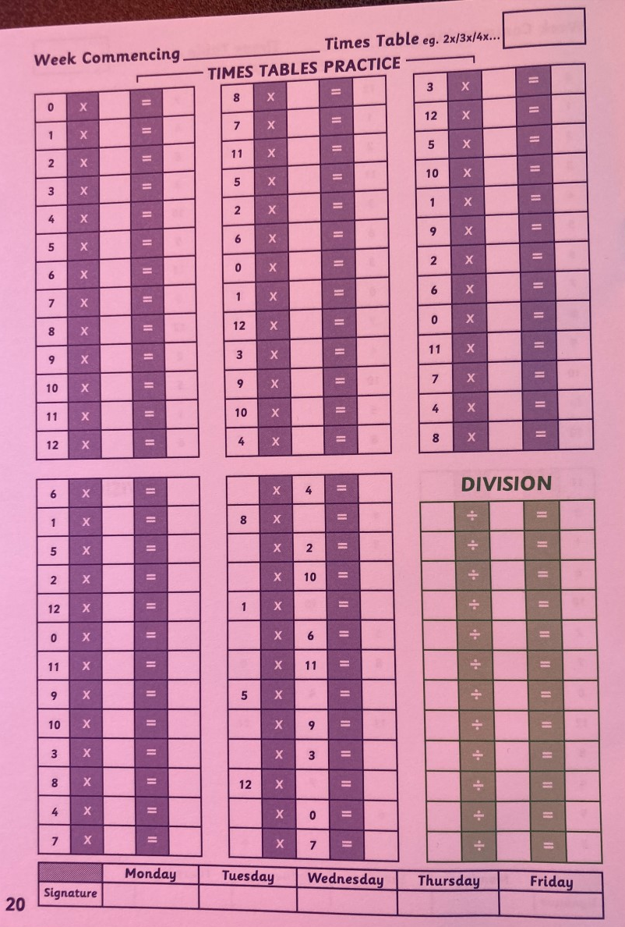
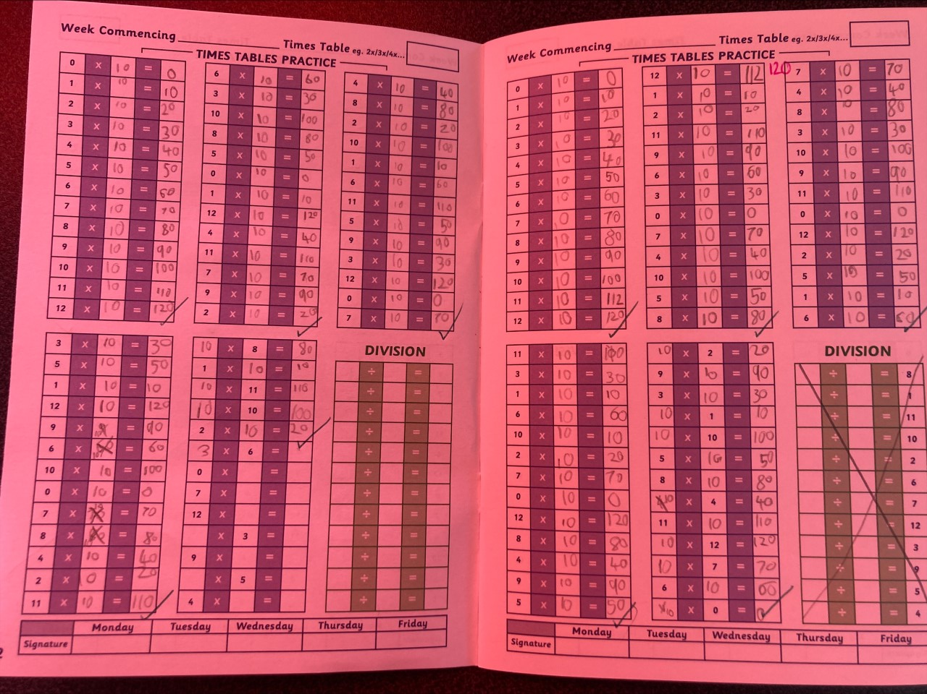
Times Tables
Children complete a times table test each week on a Friday. It is supported at first and then support is taken away each week as children become more confident.
The focus is on the
10 times table and we will
then move onto the 2s and 5s.
At the end of the year, the test will focus on a mixture of the 2, 5 and 10 times table.

Slide 22
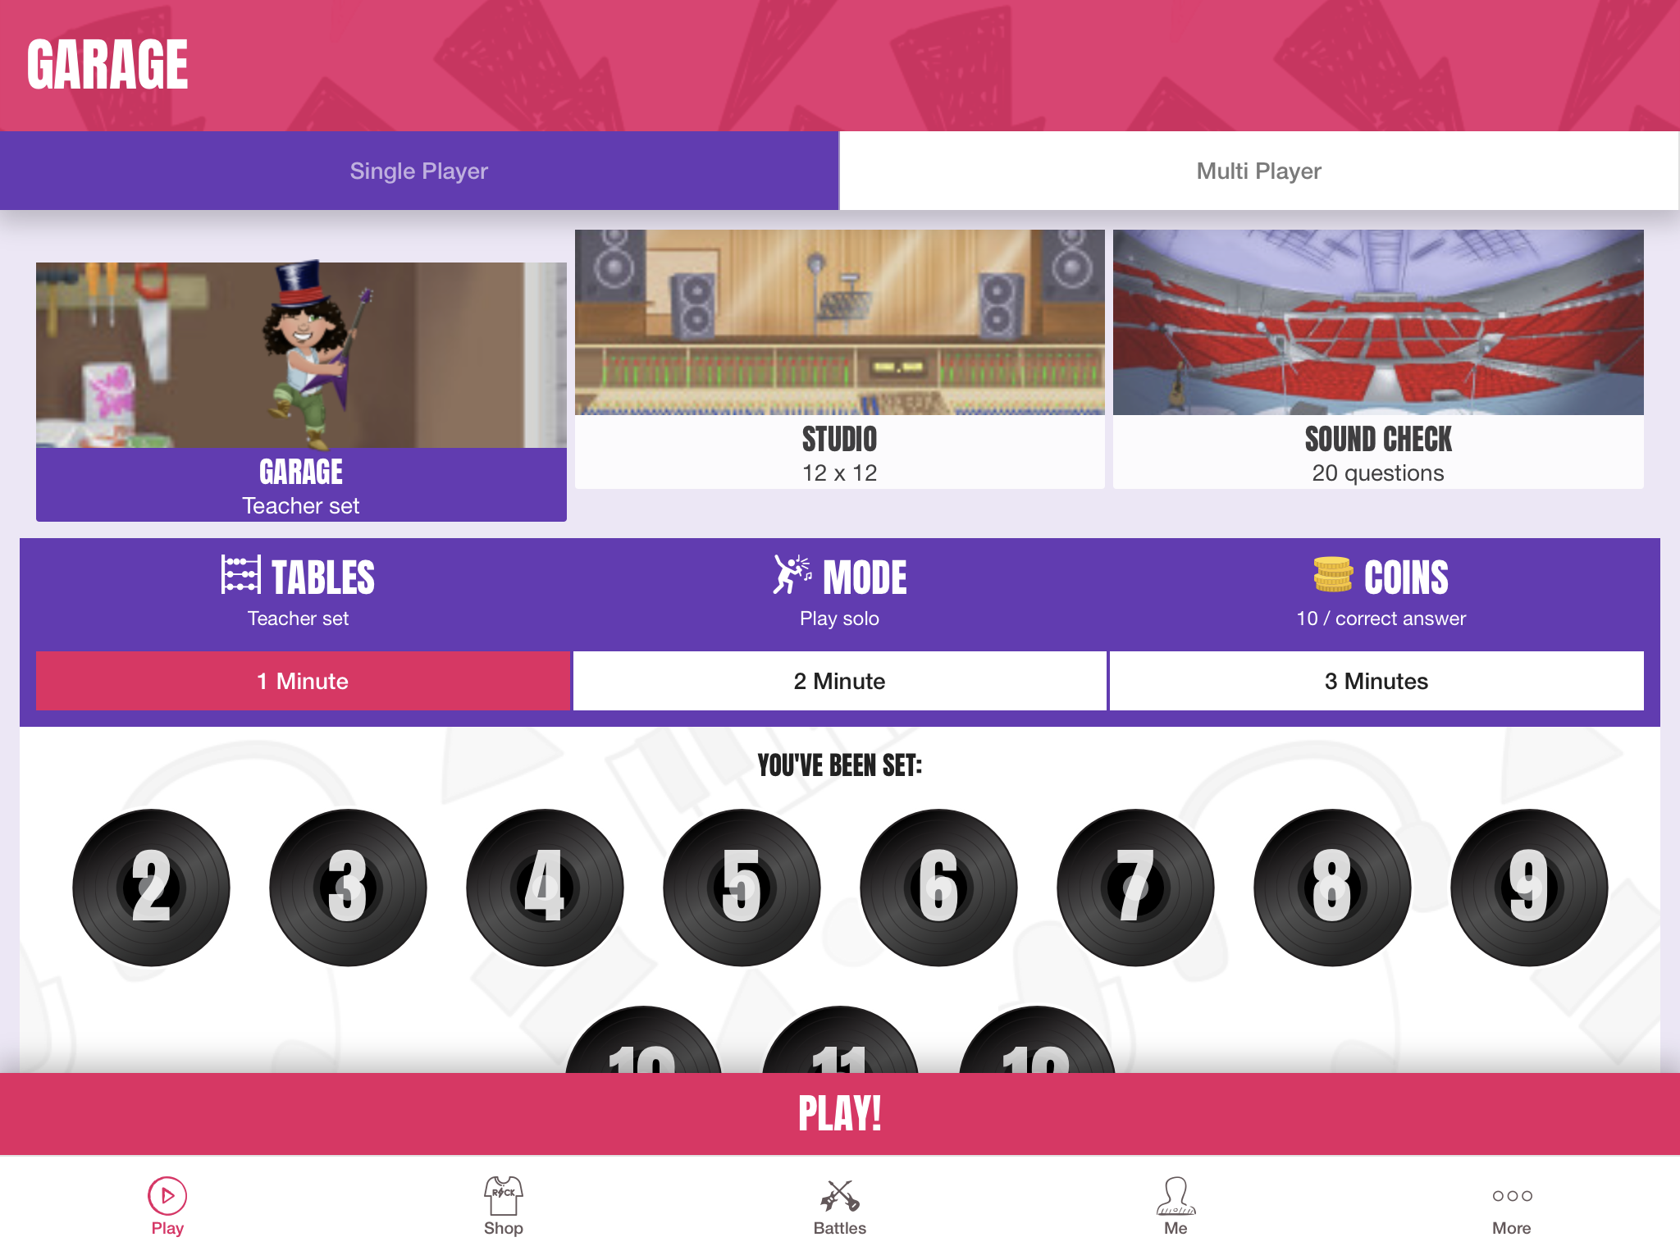
How can you help at home?
Times Table Rockstars and Numbots is an excellent resources to support Maths learning at home
Pupils must play games in the ‘Garage’ (The ‘Studio’ is every times table and is unsuitable for Y2 at this stage.)
Teachers set the times tables for their classes.
If you think your child is finding it too easy, let your child’s teacher know.
Children start with 10 times tables, then 2, 5 and 3.
In class, we have a sticker system where children earn more stickers, the more coins they have earnt.
Notes:
Talk the child through the questions

Slide 23
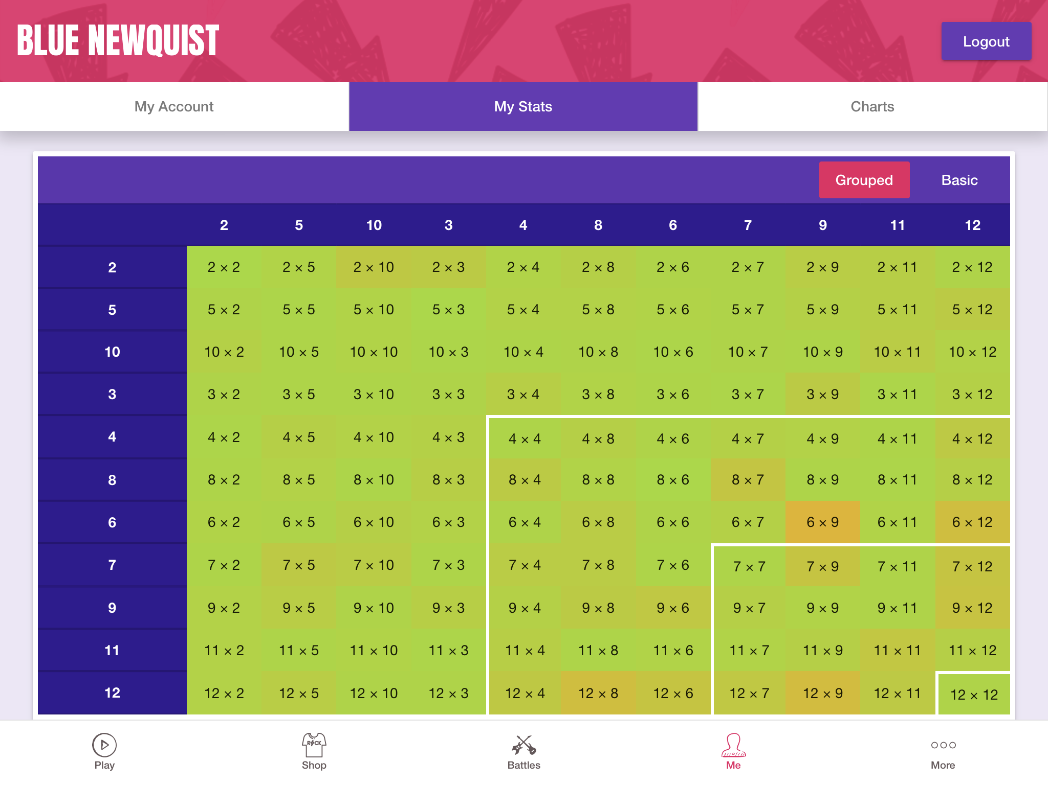
If you click ‘Me’ and ‘My Stats’ at the bottom, you can see in green, orange or red, which facts your child is finding tricky. The ‘greener’ the fact, the quicker the child’s recall.
This child is just starting to learn the 10x table.
Higher numbers x 10 still need practicing.
This Y4 child is green as recall is mostly under five seconds, apart from their 12x table and 6x9 being a weaker fact.
Notes:
4 seconds

Slide 24
Maths Assessment in Year 2
From this year, schools will no longer be required to administer the KS1 Standard Assessment Tests (SATs) for pupils in Year 2 and no longer required to submit end of Year 2 teacher assessment to the Department for Education.
We will continue to use summative assessments (such as tests, quizzes and end of unit tasks) in Year 2 as they are part of the way we assess pupils’ attainment and progress in all year groups.
In the end of year school report, we will still state whether your child is working below, working towards, working at or at the greater depth standard.

Slide 25
Arithmetic Paper (25 questions)
Year 2 Maths Assessments
Reasoning Paper
(32 questions)

Slide 26
How can you help at home?
Playing games involving numbers and maths concepts is the best way to help with maths at home.
Simple things like board games are good for practicing mental addition (dice) .
This document has been sent home and can be found on the website.

Slide 27
Thank you for coming.
Any questions?

